Slide 1
Lecture 3.1 Perfect Competition

Slide 2
Perfect Competition
Perfect competition provides a benchmark. It is only a model.
Assumptions:
Profit maximisation
Large number of firms
Perfect information
Product homogeneity
No transaction costs
Price taking (follows from the above)
Freedom of entry and exit.

Slide 3
Perfect Competition
These are very strong assumptions. When they do not apply, moving “towards freer” markets need not help.
Perfect competition is not a general statement about the world.
Perfect competition is not a goal for the firm.
Perfect competition offers a convenient benchmark for studying the effects of competitive forces.
It is a good approximation for understanding market forces in many settings.
Some industries behave in ways that are very close to perfect competition (e.g. some agricultural, labour, and financial markets).

Slide 4
Perfect Competition
Price equals marginal cost: follows from profit maximisation and price-taking / homogeneous product
Firms earn normal profits (zero economic profits): follows from free entry and exit
Note that in the short-run and the long-run the decisions are slightly different because some costs are sunk or unavoidable. In the long-run firms that remain in the industry earn zero economic profit but positive accounting profit.
We can solve for a competitive equilibrium
profit maximisation determines supply curve for each firm
demand and supply determines market price
long run equilibrium requires zero economic profits
The three equations allow us to solve for quantity (Q), price (P) and number of firms (N)

Slide 5
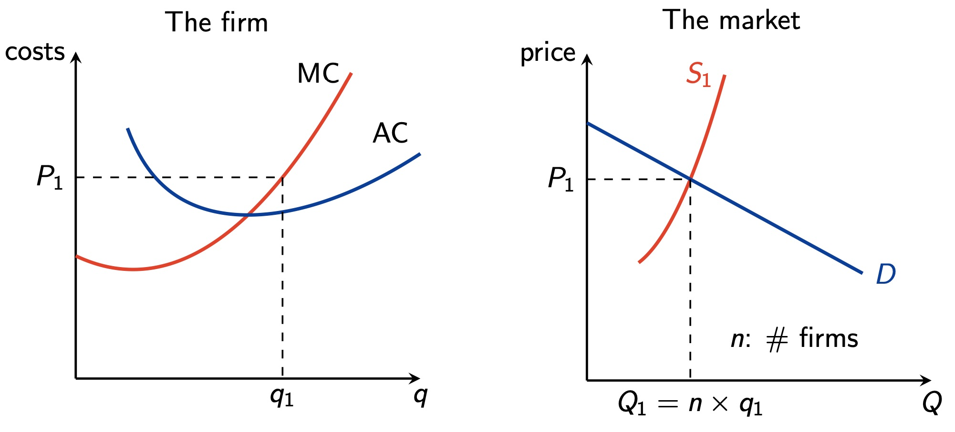
Short-run analysis
In the short-run, the number of firms is fixed (no entry or exit). Firms can make positive (or negative) profits.
At the market price P₁ > min AC, each firm produces output q₁ and makes positive profit. More firms want to enter the market.

Slide 6
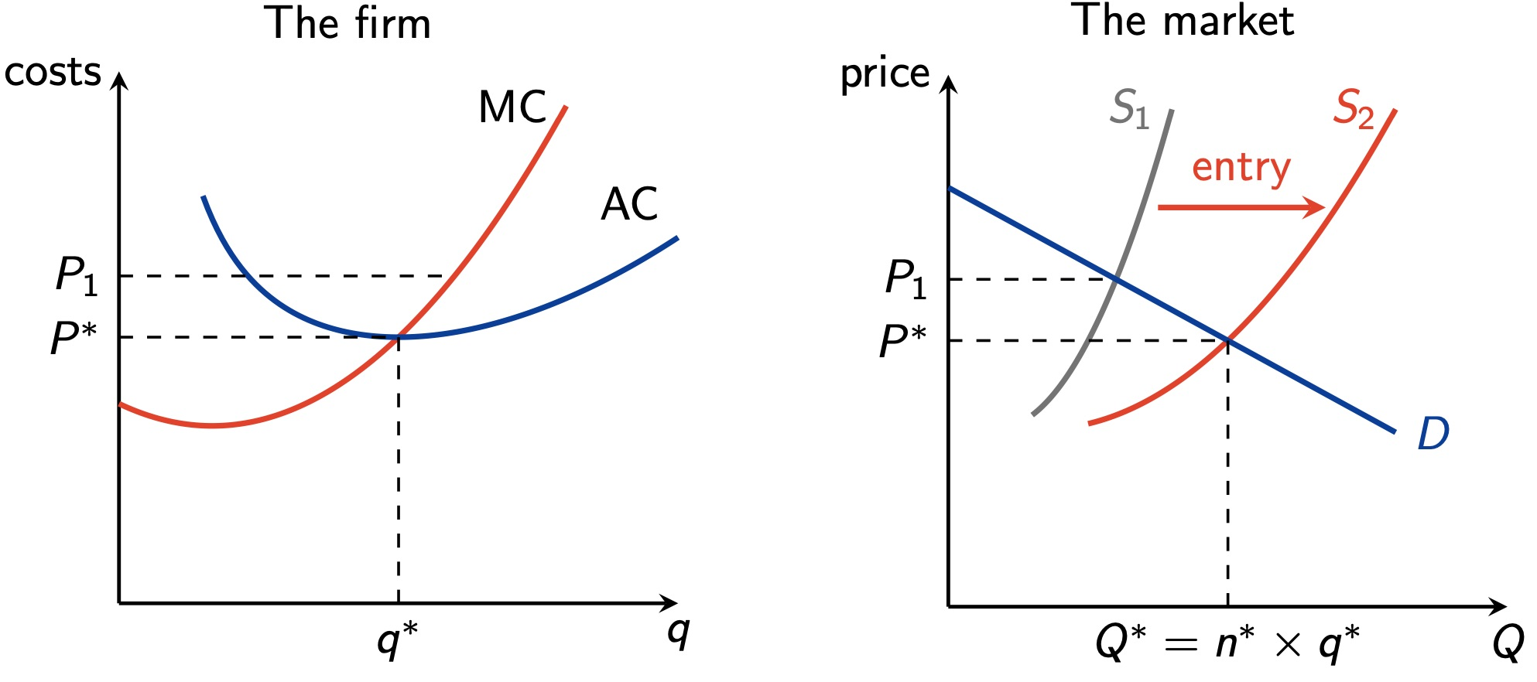
Perfect Competition
In the long run, we assume free entry. Firms make zero profits.
In the long run, more firms enter. The supply curve shifts right until the market price is such that all firms make zero profit.

Slide 7
Perfect Competition
Perfect competition is a benchmark. The real lesson is that competitive advantages are transitory.
In the long run:
Profits tend towards “zero”: each firm earns the market return (remember this refers to economic profits).
Production is efficient: firms produce at efficient scale (at minimum average cost)
Efficient allocation of resources: higher or lower output (more or fewer firms) would imply lower efficiency.

